Slide 1
ESP32 ADVANCED DEBUGGING

Slide 2
Codebase orientation
https://github.com/Mair/advanced-debugging
Git clone https://github.com/Mair/advanced-debugging.git

Slide 3
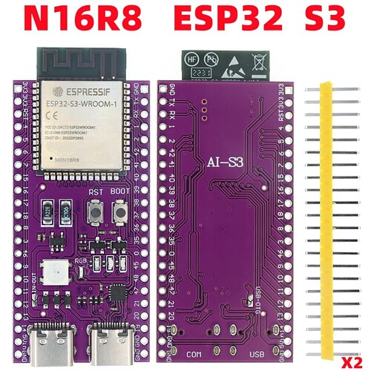
The ESP32s3

Slide 4
Logging
Log levels
supressions
Hex dump
Special vars

Slide 5
Logging
As logging is a common tool, lets do a very quick recap
5 logging levels Error, Warning, Information, Debug, Verbose
Logs have a tag
You can control the suppression via the tag
Suppressing a level will suppress all levels below it
Debug and Verbose are suppressed by default

Slide 6
Printing memory
Use ESP_LOG_BUFFER_HEXDUMP() To print memory

Slide 7
Logging vars
#include "esp_log.h"
#include "esp_debug_helpers.h"
void log_vars_demo(void)
{
// You can print information about the source line being run as follows
ESP_LOGI("TAG", "running in FILE %s on LINE %d in FUNCTION %s", __FILE__, __LINE__, __FUNCTION__);
// It's also possible to print a stack trace (without a crash) after including esp_debug_helpers
esp_backtrace_print(20);
}

Slide 8
GDB
Stepping through code
Core dump

Slide 9
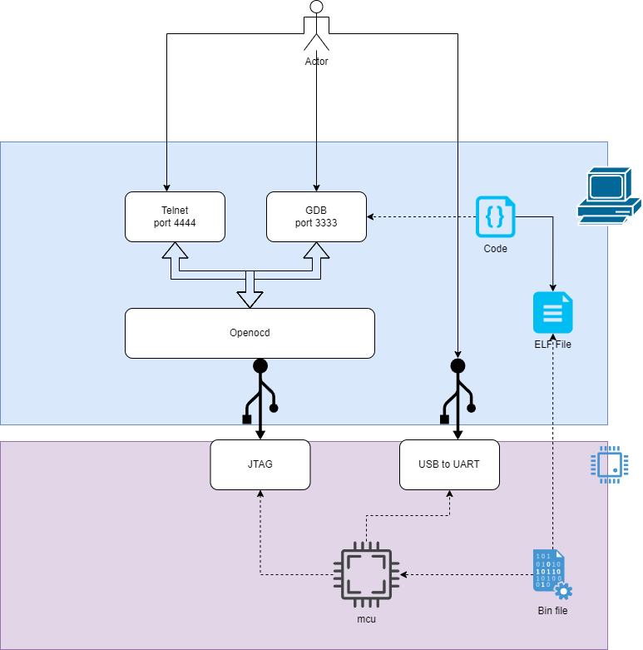
OPENOCD AND GDB

Slide 10
GDB CHEET SHEET
https://github.com/Mair/advanced-debugging/blob/master/main/_2_openocd_gdb/demo/readme.md

Slide 11
VS Code Debugging
A JATAG is required. Some chips like the S3 and C3 have JTAGS built in
For vs code debugging type `idf.py openocd`
click on the debug tab
click the green arrow to launch
vs code debugging can be very slloowww!

Slide 12
GDB
type `idf.py openocd`
Then run…
xtensa-esp32s3-elf-gdb -x build/gdbinit/connect build/<elf file>.elf
You “might” be able to use `idf.py gdb`

Slide 13
Core dump : post-crash analisys
Menuconfig->Component config->Core dump
Requires a partition entry “coredump, data, coredump,, 64K”
python {{IDF_PATH}}/components/espcoredump/espcoredump.py -p COM35 dbg_corefile build/<elf file>.elf
python {{IDF_PATH}}/tools/esp_app_trace/logtrace_proc.py apptrace_ESP_log.log build/<elf file>.elf

Slide 14
Memory
Getting memory size
Detecting leaks
Detecting buffer overruns

Slide 15
Retrieving the size of memory
You can use esp_get_free_heap_size() to get the heap size
If you need to know the size of a particular portion of memory you can use heap_caps_get_free_size(<caps>) where caps can be
MALLOC_CAP_SPIRAM
MALLOC_CAP_DMA
MALLOC_CAP_IRAM_8BIT
Etc.

Slide 16
Heap memory trace
Menuconfig->Component config->Heap memory debugging
#define NUM_RECORDS 1000
static heap_trace_record_t trace_record[NUM_RECORDS];
…
heap_trace_init_standalone(trace_record, NUM_RECORDS);
heap_trace_start(HEAP_TRACE_LEAKS);
…
heap_trace_dump();

Slide 17
Heap poisoning
Uses a cannery to detect for buffer oferrun
heap_caps_check_integrity_all(true);

Slide 18
App trace
Writing to trace
Overriding ESP_LOG functions
Using Segger sysview

Slide 19
App trace setup
You will need telnet. Telnet can be installed under windows with add / remove features):
menuconfig -> component config ->Application level tracing.
Set data destination to JTAG
idf.py openocd
telnet localhost 4444
esp apptrace start file://apptrace.log 1 -1 -1 0 0

Slide 20
App trace write
Use the following to write to the trace
esp_apptrace_write(ESP_APPTRACE_DEST_JTAG, log_text, strlen(log_text), ESP_APPTRACE_TMO_INFINITE);
You should also occasionally flush
esp_apptrace_flush(ESP_APPTRACE_DEST_JTAG, 1000);

Slide 21
Overwriting ESP_LOG functions
//override the log output
esp_log_set_vprintf(esp_apptrace_vprintf);
…
…
// dont forget to flush
esp_apptrace_flush(ESP_APPTRACE_DEST_JTAG, ESP_APPTRACE_TMO_INFINITE);
//set the log output back to default (UART)
esp_log_set_vprintf(vprintf);
To view the output, use the following command line
$IDF_PATH/tools/esp_app_trace/logtrace_proc.py /path/to/trace/file /path/to/program/elf/file

Slide 22
Segger view
menuconfig -> component config ->Application level tracing. -> FreeRtos SystemView Tracing
idf.py openocd
telnet localhost 4444
esp sysview start file://cpu0.SVDat file://cpu1.SVDat 1 -1 -1 0 0

Slide 23
Segger View continued
void sysview_printf(const char *format, ...)
{
va_list args;
va_start(args, format);
esp_sysview_vprintf(format, args);
va_end(args);
esp_sysview_flush(ESP_APPTRACE_TMO_INFINITE);
}
…
sysview_printf(“message");
…

